Slide 1

A C Primer (7): Pointer Arithmetic & Structures
Ion Mandoiu
Laurent Michel
Revised by M. Khan, J. Shi and W. Wei

Slide 2
Pointers are addresses
The value of a pointer is a byte address
Unsigned integer used to number bytes in memory
Range is between
0x00000000 and 0xFFFFFFFF [32-bit]
0x0000000000000000 and 0xFFFFFFFFFFFFFFFF [64-bit]
Corollary
If a pointer is an integer, you can do arithmetic…
To compute other addresses
int * p = malloc(sizeof(int)*10);
int * q = p + 1;

Slide 3
Pointer Addition Example
Suppose p is a pointer to an int, and its value is 1000
p + 1 is not the next byte address.
It is the address of next item (of type int)
Address | Value
1020
1016
1012
1008
1004
1000
996
992
To access values
p + 5
*(p+5) OR p[5]
p + 4
*(p+4) OR p[4]
p + 3
*(p+3) OR p[3]
p + 2
*(p+2) OR p[2]
p + 1
*(p+1) OR p[1]
p = 1000
*p OR p[0]
p - 1
*(p-1) OR p[-1]
p - 2
*(p-2) OR p[-2]

Slide 4
Adding a pointer and an integer
Add an integer to a pointer, the result is a pointer of the same type
It is different from regular integer addition
The integer is automatically scaled by the size of the type pointed to
Suppose p is a pointer to type T, and k is an integer
Then both p + k and k + p
Are valid expressions that evaluate to a pointer to type T
Have a byte address equal to
(unsigned long)(address stored in p) + k * sizeof(T)
C standard does not allow arithmetic on void *
gcc has an extension, treating sizeof(void) as 1

Slide 5
Pointers Subtraction
Subtract one pointer from another: both must have the same type
The result is the number of data items between the two pointers!
Not the number of bytes
#include <stdio.h>
#include <stdlib.h>
int main() {
int *p = malloc(sizeof(int)*10);
int *last = p + 9;
int dist = last - p; // both are int *
printf("Distance is %d\n",dist);
free(p);
return 0;
}
Output
$ gcc ptrsub.c
$ ./a.out
Distance is 9
$

Slide 6
Pointer comparisons
You can also compare two pointers
< > <= >= != ==
Purpose
Check boundary conditions in arrays
Manually manage memory blocks
Semantics
Simply based on memory layout!
Compare bits in pointers as unsigned integers!
Check if you are done:
while (b < a) {
// do something
}
0xffffffff
a
b
0x00000000
Notes:
If pointers are of different types:
warning: comparison of distinct pointer types lacks a cast

Slide 7
Effect of casting types ?
If you cast a pointer type…
Any subsequent pointer arithmetic will use the type you chose
Do not want scaling? Casting a pointer to (char *)
Because sizeof(char) is 1
int * t;
char * p = (char *) t + 8; // 8 is not scaled
char * q = (char *) (t + 8); // 8 is scaled
Notes:
Hence the scaling constants are different

Slide 8
Arrays and pointers
Arrays and pointers can often be used interchangeably
int a[10];
int *p = a;
// all of the following evaluate to the value of a[0]
*p p[0] *a a[0]
// all of the following evaluate to the value of a[1]
*(p+1) p[1] *(a+1) a[1]
// all of the following evaluate to the address of a[0]
// type is int *
p &p[0] a &a[0]
"array of int" becomes "pointer to int" (array decay)
Notes:
Cannot operate on array, but can operate on pointer
C99 6.3.2.1/3 - Other operands - Lvalues, arrays, and function designators
Except when it is the operand of the sizeof operator or the unary & operator, or is a string literal used to initialize an array, an expression that has type ‘‘array of type’’ is converted to an expression with type ‘‘pointer to type’’ that points to the initial element of the array object and is not an lvalue.

Slide 9

Example: arrays and pointers
Equivalent ways of initializing an array
int a[10], *p = a; // not *p = a; it is int *p; p = a;
for(int i=0; i<10; i++) a[i] = i; // array indexing
for(int i=0; i<10; i++) p[i] = i; // indexing via pointer
for(int i=0; i<10; i++) *(p+i) = i; // explicit pointer arithmetic
for(i=0; i<10; i++) i[p] = i; // obfuscated but valid C!
for(i=0; i<10; i++) *p++ = i; // common pointer use idiom
int * tp = p;
p ++;
*tp = i;

Slide 10
Arrays and pointers are NOT the same
int a[10];
int *p = a; // a is converted to int *
// a is still an array after &
&a // pointer to array of 10 int's int (*)[10]
&p // pointer to a pointer to int int **
// a is still an array after sizeof
sizeof(a) // 40 because a is an array of 10 int's
sizeof(p) // 8 because p is a pointer
p++; // can increment p
a++; // cannot increment a; this will not compile
// Similar to n++ vs 2++

Slide 11
Example: Arrays and pointers are NOT the same
#include <stdio.h>
void foo(int *x)
{
printf("%lu\n", sizeof(x));
}
int main()
{
int a[10], *p;
p = a; // a is converted to int *
// a is still an array in sizeof
printf("%lu %lu\n", sizeof(a), sizeof(p));
foo(a); // a is converted to int *
}
Output
% gcc array.c
% ./a.out
40 8
8
Notes:
// cannot do int a[] here.

Slide 12
Structures
Mechanism to define new types
Also known as “compound types”
Used to aggregate related variables of different types
Structures type declaration
Structures can have a type name
Can have “members” of any type
Basic types
Pointers
Arrays
Other structures
Structure variable definition
Specifies variable name
struct student_grade {
char *name;
int id;
char grade[3];
};
…
struct student_grade student1;
struct student_grade
student2, student3;
struct student_grade all[200];
Notes:
Allocates necessary memory, but does not initialize it

Slide 13
Structure example
struct Person {
int age;
char gender;
};
int main(){
struct Person p;
p.age = 44;
p.gender = 'M';
struct Person q = {44, 'M'};
return 0;
}
Structure type declaration
Structure variable definition
Syntax for field access
similar to Java and Python
Structure variable definition
and initialization

Slide 14
Example: Array of Structures
Member name is a char array
Caveats
Names cannot be more than 31 characters long
Four persons in family
Indexed 0..3
Array of structures for the whole family
Nested initializers
#include <stdlib.h>
struct Person {
char name[32];
int age;
char gender;
};
int main()
{
struct Person family[4] = {
{"Alice",34,'F'},
{"Bob",40,'M'},
{"Charles",15,'M'},
{"David",13,'M'}
};
int juniorAge = family[3].age;
return 0;
}

Slide 15
typedef
Struct names can become long
C provide the ability to define type abbreviations
typedef declaration
Give existing type new type name
Make code more readable
struct Person {
char name[32];
int age;
char gender;
};
typedef struct Person TPerson;
int main()
{
TPerson family[4];
...
return 0;
}
typedef struct Person {
char name[32];
int age;
char gender;
} TPerson;
Structure and typedef declarations often combined

Slide 16
Operations on struct
Assignment
All struct members copied
Can be passed to functions
By value
Even if some members are arrays!
Can be returned from a function
If pass by value, cannot change members in functions
Passing or returning large structures can be costly
Use pointers to structures!
TPerson a, b, c;
…
a = b;
c = searchPerson("name");

Slide 17
Pass structure by reference
typedef struct Person {
char name[32];
int age;
char gender;
} TPerson;
TPerson * init_Person(TPerson *p, char * name, int age, char gender)
{
strcpy(p->name, name); // (*p).name
p->age = age; // (*p).age
p->gender = gender; // (*p).gender
return p;
}

Slide 18
Structure Alignment
Structure members are aligned for the natural types
Alignment requirements on x64 architecture
char | 1
short | 2
int | 4
long | 8
float | 4
double | 8
struct struct_random {
char x[5]; // bytes 0-4
int y; // bytes 8-11
double z; // bytes 16-23
char c; // byte 24
}; // Total size 32
struct struct_sorted {
double z; // bytes 0 - 7
int y; // bytes 8 - 11
char x[5]; // bytes 12 - 16
char c; // byte 17
}; // Total size 24

Slide 19
Study the remaining slides yourself.
Also study the demo code!

Slide 20
Arrays and pointers
Copying arrays
// using array indexing
void copy_array0(int source[], int target[], int n)
{
for(int i = 0; i < n; i++)
target[i] = source[i];
}
// using pointers
void copy_array1(int source[], int target[], int n)
{
for(int i = 0; i < n; i++)
*target++ = *source++;
}
int * tp = source;
source ++;
*target = *tp;
target ++;

Slide 21
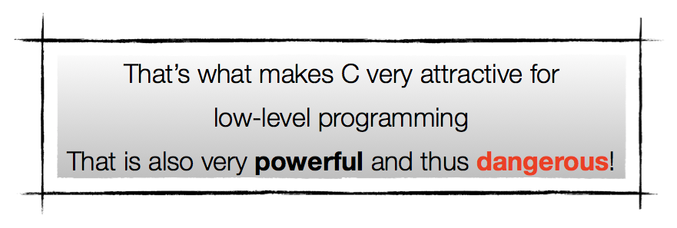
Typecasting Pointers
C lets you cast pointers in any way you like
You can “forge” pointers to point wherever you wish….
float f;
char p = * (char *) &f; // 1st byte representing f
char ch = * (char *)1000; // access any byte in memory
Notes:
C is permissive
It will let you cast pointers in any way you like
This is called “weak typing”

Slide 22
Returning more than one value from functions
Use references (caller prepares the storage)
long int strtol (const char* str, char** endptr, int base);
Use arrays (caller prepares the storage)
int pipe(int pipefd[2]);
Return a structure (costly if structure is large)
Return a pointer (to array or structure)
Must be dynamically allocated or static. RTM (read the manual)!
char * strdup(const char *str1);
struct tm *localtime( const time_t *time );
Use global variables (DON’T!)
errno

Slide 23
Typedef
// Example of typedef. Think about how you would define a variable
typedef int BOOL;
typedef char name_t[100];
typedef char *Pointer;

Slide 24
Self-referential structures
struct Person {
int age;
char gender;
char name[32];
struct Person * parents; // A pointer to this type of struct
} person1, person2; // Can define variables here

Slide 25
Self-referential structures - 2
struct student {
char name[128];
// Can have a pointer to a struct defined later.
// However, you cannot define an array of book here (e.g. books[8])
struct book * books;
};
struct book {
char title[128];
struct student * owner;
struct book * next; // A pointer to this type of struct
};

Slide 26
Example of Pointer Arithmetic
Simple illustration
#include <stdlib.h>
int main()
{
int *tab = (int*)malloc(sizeof(int)*10);
tab[3] = 10;
int *p = tab + 3;
printf(“What is at tab+3? = %d\n”,*p);
*p = 20;
printf(“What is at tab[3]? = %d\n”,tab[3]);
return 0;
}
0
1
2
3
4
9
tab

Slide 27
Example
Simple illustration
#include <stdlib.h>
int main()
{
int *tab = (int*)malloc(sizeof(int)*10);
tab[3] = 10;
int *p = tab + 3;
printf(“What is at tab+3? = %d\n”,*p);
*p = 20;
printf(“What is at tab[3]? = %d\n”,tab[3]);
return 0;
}
0
1
2
3
4
9
10
tab

Slide 28
Example
Simple illustration
#include <stdlib.h>
int main()
{
int *tab = (int*)malloc(sizeof(int)*10);
tab[3] = 10;
int *p = tab + 3;
printf(“What is at tab+3? = %d\n”,*p);
*p = 20;
printf(“What is at tab[3]? = %d\n”,tab[3]);
return 0;
}
0
1
2
3
4
9
10
tab
p

Slide 29
Example
Simple illustration
#include <stdlib.h>
int main()
{
int *tab = (int*)malloc(sizeof(int)*10);
tab[3] = 10;
int *p = tab + 3;
printf(“What is at tab+3? = %d\n”,*p);
*p = 20;
printf(“What is at tab[3]? = %d\n”,tab[3]);
return 0;
}
0
1
2
3
4
9
20
tab
p

Slide 30
But what about memory addresses?
Same story…!
0
1
2
3
4
9
tab
0x11110000
tab+1 = ?
0x11110001 ?

Slide 31
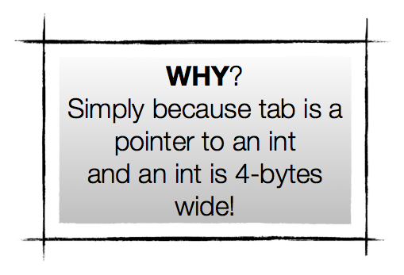
But what about memory addresses?
Same story…!
0
1
2
3
4
9
tab
0x11110000
tab+1 = ?
0x11110001 ?
0x11110004 ?

Slide 32
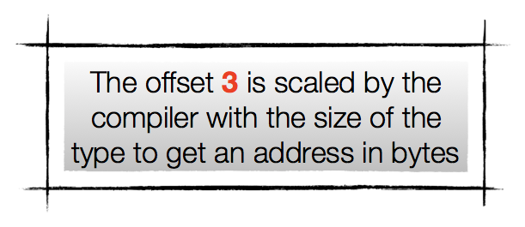
Bottom line
#include <stdlib.h>
int main()
{
int *tab = (int*)malloc(sizeof(int)*10);
tab[3] = 10;
int *p = tab + 3;
printf(“What is at tab+3? = %d\n”,*p);
*p = 20;
printf(“What is at tab[3]? = %d\n”,tab[3]);
return 0;
}
0
1
2
3
4
9
tab
p = tab+3 = tab + 3 * sizeof(int) = tab + 3 * 4
0x11110000
0x1111000c

Slide 33
Memory alignment requirements
Memory used to store a value of type X MUST
be lined-up on a multiple of natural alignment for X
Why?
Performance!
If you do not respect alignment requirements…
BUS ERROR (sigbus)
The O.S. will kill your program

Slide 34
Good news and bad news
The C compiler handles alignment automatically 99% of the time
Programmers have to handle the rest
When you do pointer arithmetic of course!
Do not assume the location of the fields
When you call system routines with specific alignment needs
Your arguments must comply
Use compiler annotations to force specific alignments (beyond our scope, simply remember that this exists!)
Notes:
You must understand the layout (and padding) of structures to correctly compute addresses within the structure!

Slide 35
Example
#include <stdio.h>
struct Person {
char name[32];
int age;
char gender;
};
typedef struct Person TPerson;
TPerson init(char name[], int age, char gender) {
TPerson p;
int i;
for(i = 0; name[i]>0; i++)
p.name[i] = name[i];
p.name[i] = '\0';
p.age = age;
p.gender = gender;
return p;
}
void print_info(TPerson p) {
printf("name: %s, age: %d, gender: %c\n",
p.name, p.age, p.gender);
}
int main() {
TPerson family[4];
family[0] = init("Alice",34,'F');
family[1] = init("Bob",40,'M');
family[2] = init("Charles",15,'M');
family[3] = init("David",13,'M');
print_info(family[0]);
print_info(family[1]);
print_info(family[2]);
print_info(family[3]);
family[1] = family[0];
print_info(family[1]);
return 0;
}
Output
./a.out
name: Alice, age: 34, gender: F
name: Bob, age: 40, gender: M
name: Charles, age: 15, gender: M
name: David, age: 13, gender: M
name: Alice, age: 34, gender: F

